Slide 1
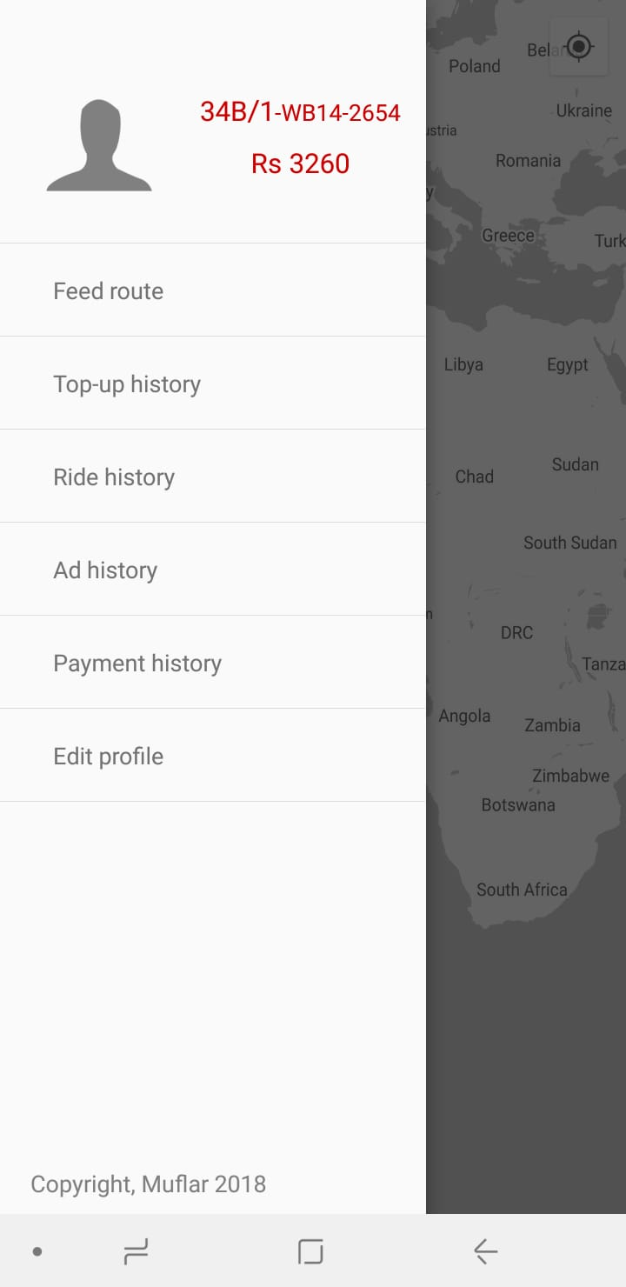
Parameter Input: BusID
Table 3 – BusRoute
http://54.179.159.226:5000/busroute/BusID
Remove This
Parameter Input: BusRoute
Table 10 – Driver
http://54.179.159.226:5000/driver/BusID
Sign out
Parameter Input: BusRoute
Table 11 – dTransaction
http://54.179.159.226:5000/dTransaction/TotalAmount

Slide 2
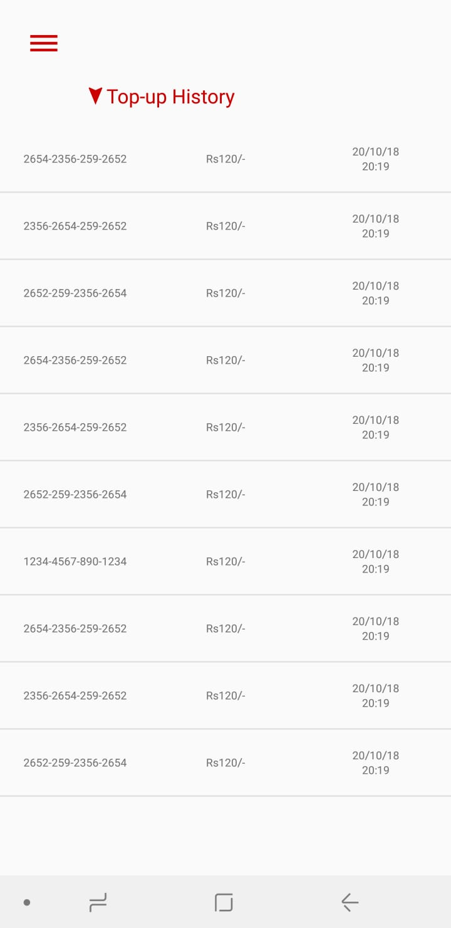
Parameter Input: Recharge_Date
Table 7- Topup History
Url: http://54.179.159.226:5000/topuphistory/BusID/BusID
Parameter Input: Recharge_Time
Table 7- Topup History
Url: http://54.179.159.226:5000/topuphistory/BusID/BusID
Parameter Input: Amount
Table 7- Topup History
Url: http://54.179.159.226:5000/topuphistory/BusID/BusID
Parameter Input: CardID
Table 7- Topup History
Url: http://54.179.159.226:5000/topuphistory/BusID/BusID

Slide 3
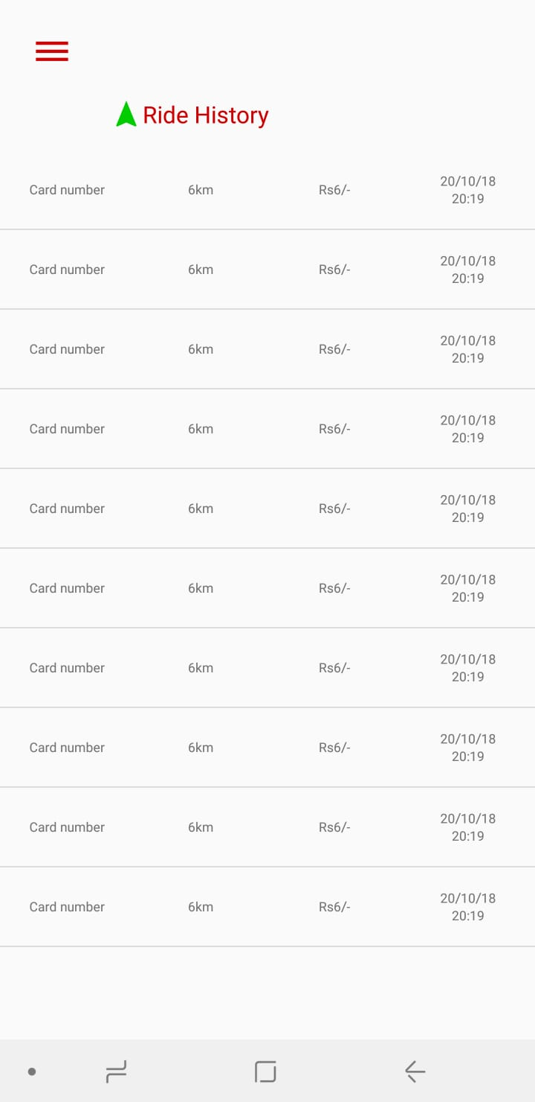
Parameter Input: Travel_Date*
Table 8- Ride History
http://54.179.159.226:5000/rideHistoryD/BusID
Parameter Input: Entry_Time*
Table 8- Ride History
http://54.179.159.226:5000/rideHistoryD/BusID
Parameter Input: FareCharged
Table 8- Ride History
http://54.179.159.226:5000/rideHistoryD/BusID
Parameter Input: CardID
Table 8- Ride History
http://54.179.159.226:5000/rideHistoryD/BusID

Slide 4
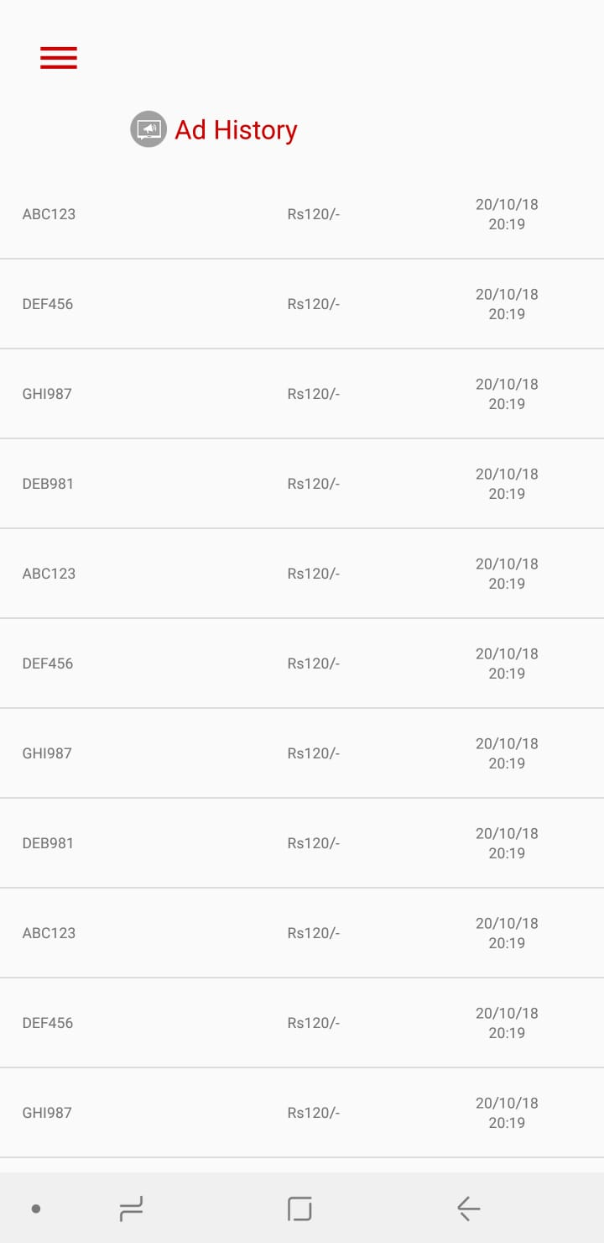
REMOVE THE PAGE

Slide 5
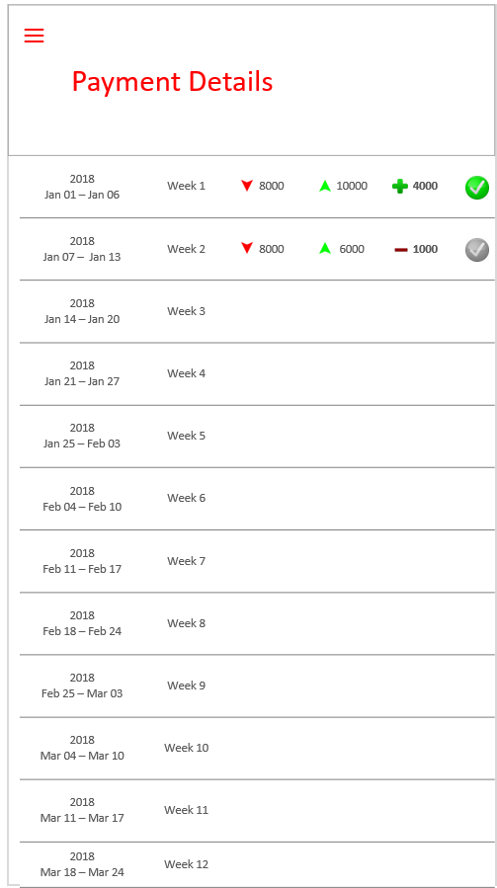
Parameter Input: RideAmount
Table 11- dTransaction
http://54.179.159.226:3000/totalAmount/byBus/BusID
Parameter Input: TotalAmount
Table 11- dTransaction
http://54.179.159.226:3000/totalAmount/byBus/BusID
Parameter Input: TopupAmount
Table 11- dTransaction
http://54.179.159.226:3000/rideHistory/byBus/BusID
Parameter Input: Week
Table 11- dTransaction
http://54.179.159.226:3000/topupHistory/byBus/BusID
Parameter Input: EndDate
Table 11- dTransaction
http://54.179.159.226:3000/topupHistory/byBus/BusID
Parameter Input: Year
Table 11- dTransaction
http://54.179.159.226:3000/topupHistory/byBus/BusID
Parameter Input: StartDate
Table 11- dTransaction
http://54.179.159.226:3000/topupHistory/byBus/BusID

Slide 6
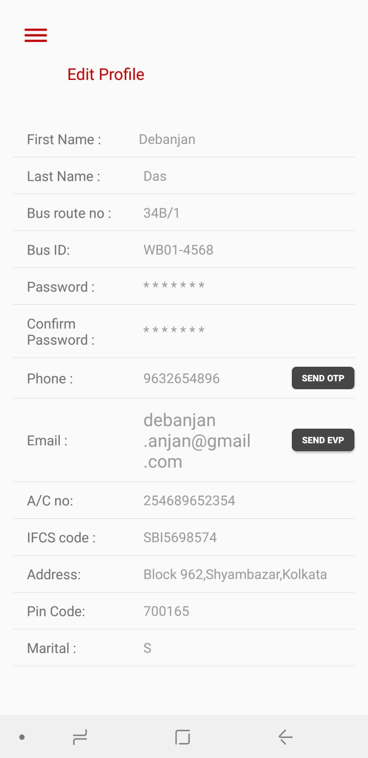
BUS ID is uneditable
Show and Edit
Table 10- Driver
http://54.179.159.226:5000/driver/BusID
Show and Edit
API type: Post
Table 10- Driver (All)
Table 2: Bus (BusID, FirstName, LastName)
Table 3: BusRoute (Busroute, BusID)
http://54.179.159.226:5000/driver/??
SAVE

